Slide 1
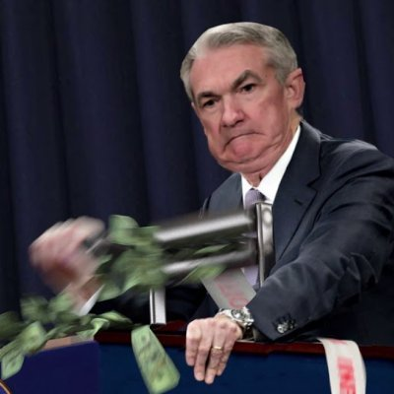
MoneyMaker

Slide 2

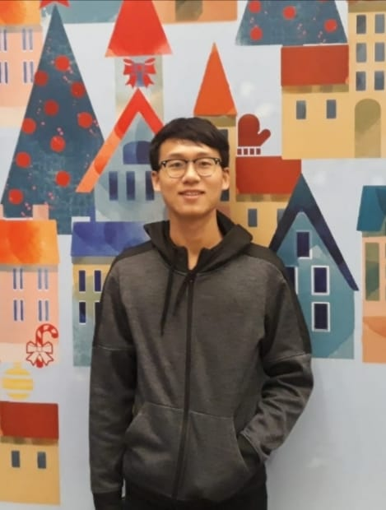
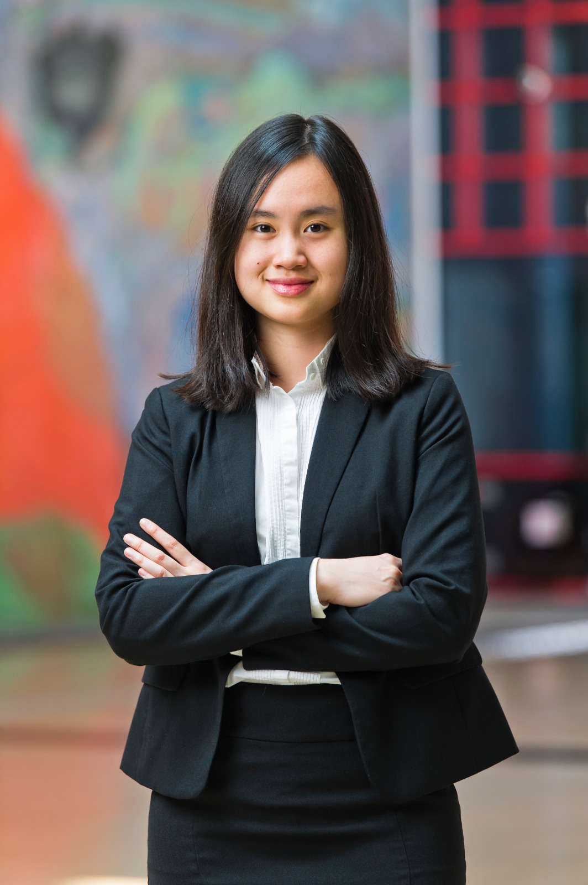
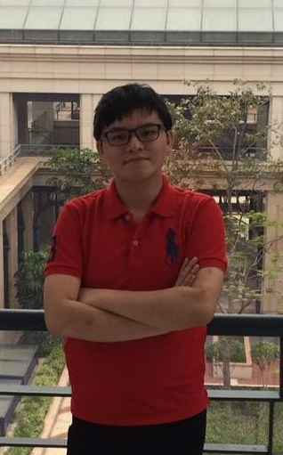
Team Information
HORTHIWONG Noppasin
Analyst
City University of Hong Kong
Finance
NAOTHAWORN Nuttapat
Analyst
City University of Hong Kong
Computational Finance
Thea Orabelle Teguh
Analyst
City University of Hong Kong
Computational Finance
DAWIEANG Phudis
Programmer/Tester
City University of Hong Kong
Computer Science

Slide 3
Trading Ideas
Utilizing the price movement of securities
2 timeframes : daily and weekly Sample Moving Average (SMA) & daily and weekly price action candlesticks
Gain profit by holding securities for a certain period of time
Trade stocks with high trading volume
Low volatility stocks

Slide 4
Trading Ideas
Trade CFDs
Low margin requirement but higher potential returns, no need to own the underlying asset
Use candlesticks for 20 timeframes to derive the SMA

Slide 5
Trading Ideas
Swing market movement
Identify where the swing starts and ends
Capture the swing price with statistical data of the market
Bullish and bearish strategy
Detect the change in weekly price before making a decision
SMA time = past prices / no of stock prices

Slide 6
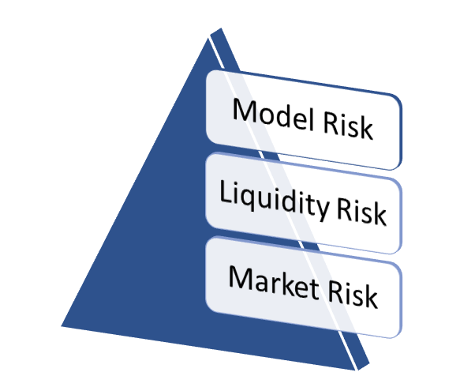
Risk Management

Slide 7
Capital Management
Trading on margin
Margin call
Preserve capital >= 25% of total securities value

Slide 8
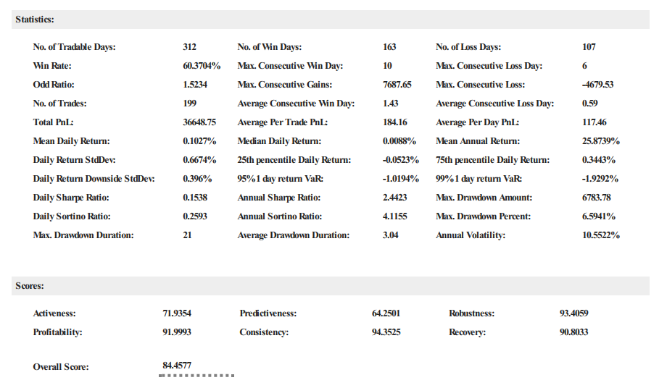
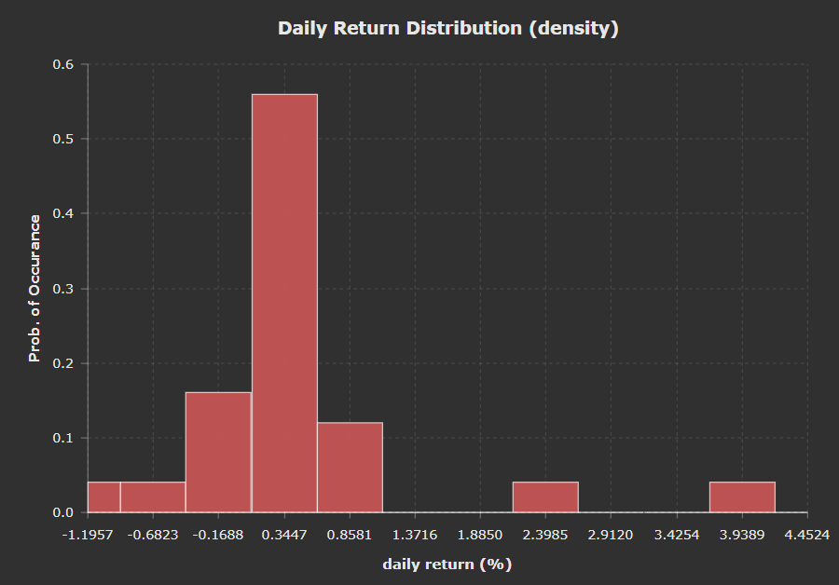
Result
NSXUSD
100K USD Capital from Jan 2016 to Dec 2017
25.8% Mean Annual Return
6.6% Maximum Drawdown

Slide 9
Buy-sell Order

Slide 10
Q&A

